Slide 1
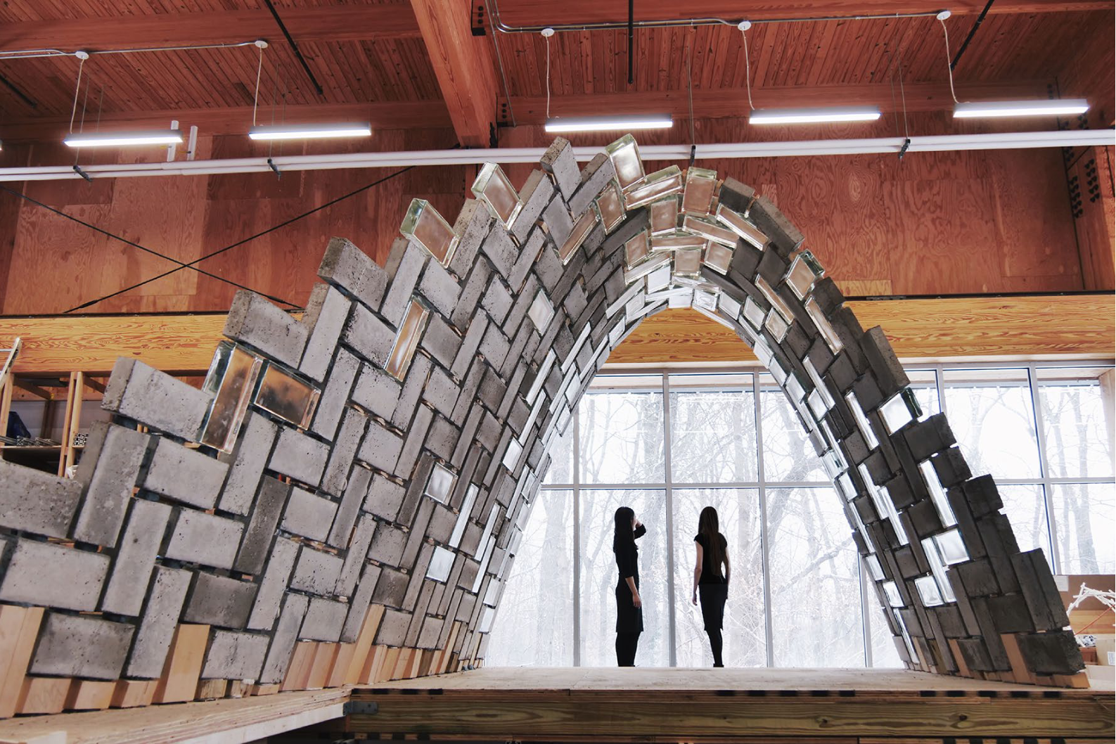
MARL
for Assembly of a Spanning Structure
Gabriel Vallat
Midterm presentation

Slide 2
Task

Slide 3
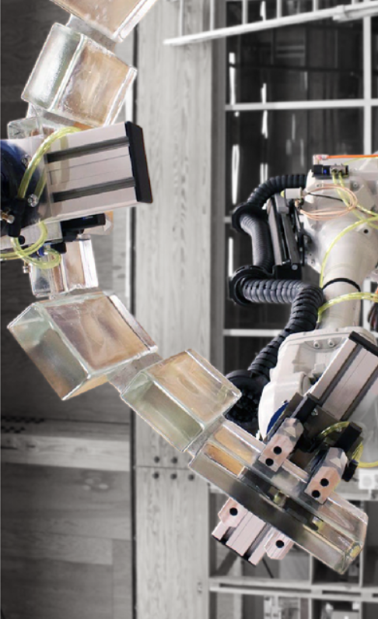
Aim
What:
Teach robots to cooperate to build a self-supporting structure
The precise dynamics of the robots are ignored
The aim: learn where the blocks should be put, irrespective of how
How:
Using (multi-agent) reinforcement learning
With a custom simulator

Slide 4
Construction as an MDP

Slide 5
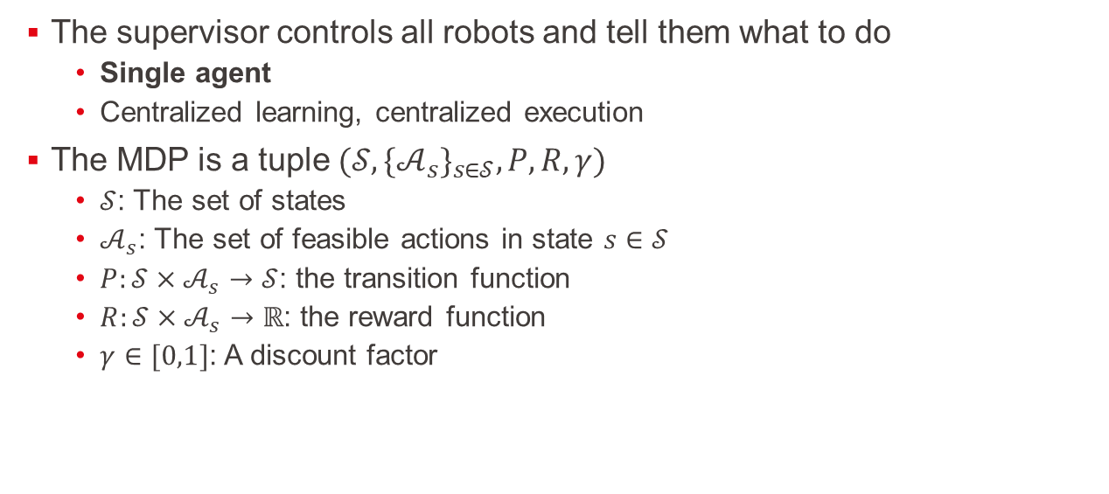
Construction as an MDP
The supervisor controls all robots and tell them what to do
Single agent
Centralized learning, centralized execution
The MDP is a tuple $(𝒮,{\{𝒜_{s}\}}_{s∈𝒮},P,R,γ)$
$𝒮$: The set of states
$𝒜_{s}$: The set of feasible actions in state $s∈𝒮$
$P:𝒮×𝒜_{s}→𝒮$: the transition function
$R:𝒮×𝒜_{s}→ℝ$: the reward function
$γ∈[0,1]$: A discount factor

Slide 6
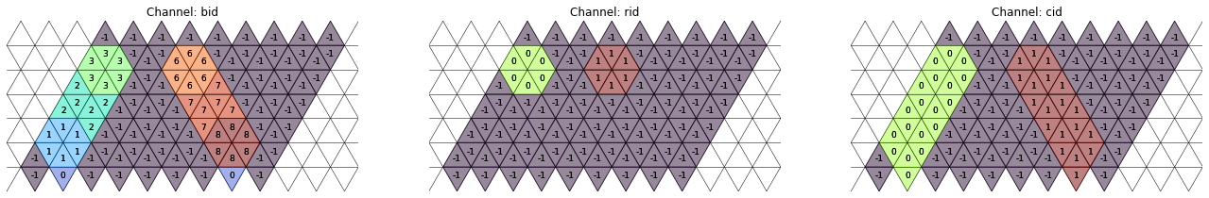
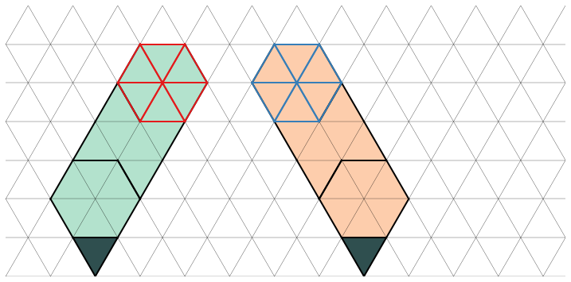

Construction as an MDP
$s\left(t\right)=\left(s_{sim},r_{i}\right)∈𝒮=𝒮_{sim}×\{r_{1},…,r_{n}\}$
The state a time $t$ is that the robot $i$ has to act and the simulation is in state $s_{sim}$

Slide 7
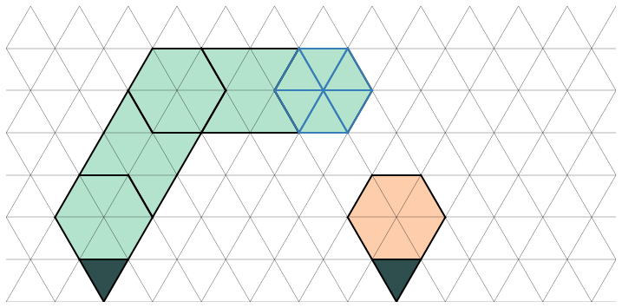

Construction as an MDP
Forbidden set $ℱ_{s}⊂𝒜_{s}$
Forbidden $≠$ Not feasible
${a∈ℱ}_{s}$ if :
The physical equilibrium is broken
There is a collision
$P\left(s,a\right)=s_{T} if a∈ℱ_{s}$
$R\left(s,a\right)=c with c<0 if a∈ℱ_{s}$

Slide 8
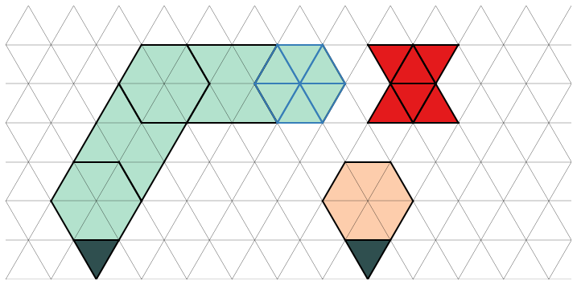

Construction as an MDP
$$a∉𝒜_{s}$$
Forbidden set $ℱ_{s}⊂𝒜_{s}$
Forbidden $≠$ Not feasible
${a∈ℱ}_{s}$ if :
The physical equilibrium is broken
There is a collision
$P\left(s,a\right)=s_{T} if a∈ℱ_{s}$
$R\left(s,a\right)=c with c<0 if a∈ℱ_{s}$

Slide 9
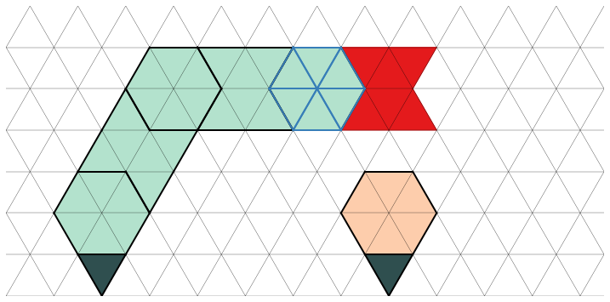

Construction as an MDP
$$a∈ℱ_{s}$$
Forbidden set $ℱ_{s}⊂𝒜_{s}$
Forbidden $≠$ Not feasible
${a∈ℱ}_{s}$ if :
The physical equilibrium is broken
There is a collision
$P\left(s,a\right)=s_{T} if a∈ℱ_{s}$
$R\left(s,a\right)=c with c<0 if a∈ℱ_{s}$

Slide 10
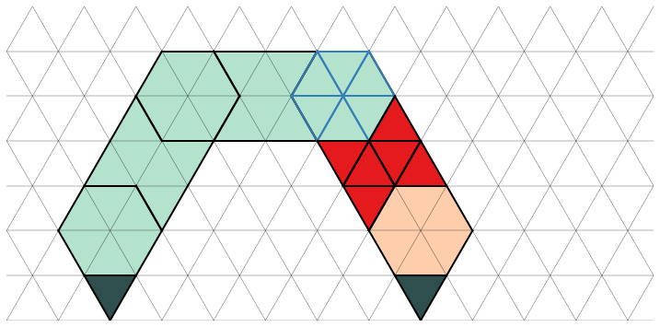

Construction as an MDP
$$a∈𝒜_{s}∖ℱ_{s}$$
Forbidden set $ℱ_{s}⊂𝒜_{s}$
Forbidden $≠$ Not feasible
${a∈ℱ}_{s}$ if :
The physical equilibrium is broken
There is a collision
$P\left(s,a\right)=s_{T} if a∈ℱ_{s}$
$R\left(s,a\right)=c with c<0 if a∈ℱ_{s}$

Slide 11
Construction as a Markov game

Slide 12
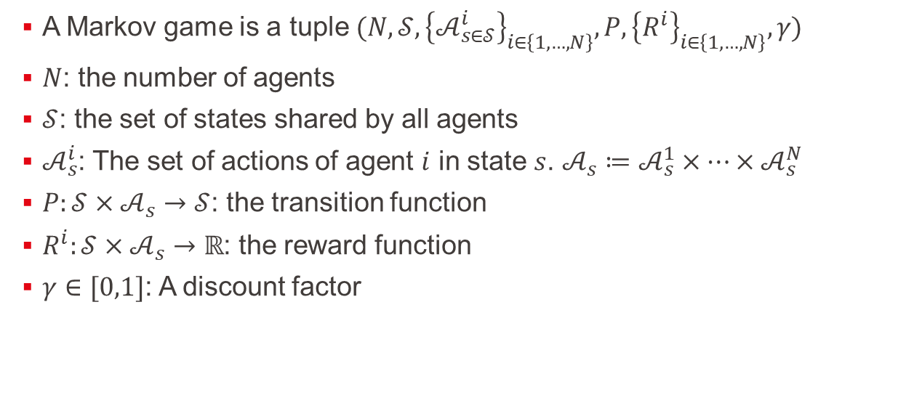
Construction as a Markov game
A Markov game is a tuple $(N,𝒮,{\left\{𝒜_{s∈𝒮}^{i}\right\}}_{i∈\left\{1,…,N\right\}},P,{\left\{R^{i}\right\}}_{i∈\left\{1,…,N\right\}},γ)$
$N$: the number of agents
$𝒮$: the set of states shared by all agents
$𝒜_{s}^{i}$: The set of actions of agent $i$ in state $s$. $𝒜_{s}≔𝒜_{s}^{1}×…×𝒜_{s}^{N}$
$P:𝒮×𝒜_{s}→𝒮$: the transition function
$R^{i}:𝒮×𝒜_{s}→ℝ$: the reward function
$γ∈[0,1]$: A discount factor

Slide 13
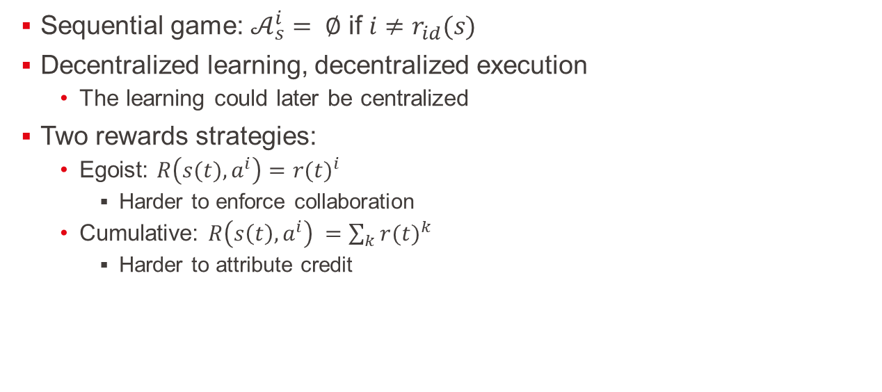
Construction as a Markov game
Sequential game: $𝒜_{s}^{i}= ∅$ if $i≠r_{id}(s)$
Decentralized learning, decentralized execution
The learning could later be centralized
Two rewards strategies:
Egoist: $R\left(s(t),a^{i}\right)={r(t)}^{i}$
Harder to enforce collaboration
Cumulative: $R{\left(s\left(t\right),a^{i}\right)}^{ }=\sum_{k}{{r(t)}^{k}}$
Harder to attribute credit

Slide 14
Environment

Slide 15



Chose an action
Simulator
$$𝒜_{f}(s)$$
$$s$$
actor
Agent 0
$$a_{ }∼π(s)$$
encoder
critic
$$s$$
$$𝒜_{f}\left(s\right)=∅$$
actor
Agent 1
encoder
critic

Slide 16

Update the policy
Buffer of past transitions
Mini-Batch
Mini-Batch
s’
r
a
s
Target network
Agent i
actor
S
encoder
$$V\left(s\right)=r+γV(s^{′})$$
critic
S’
Used to estimate a value
Used to update the actor parameters
Used to update the critic parameters
Expected discounted cumulative reward of s
s

Slide 17
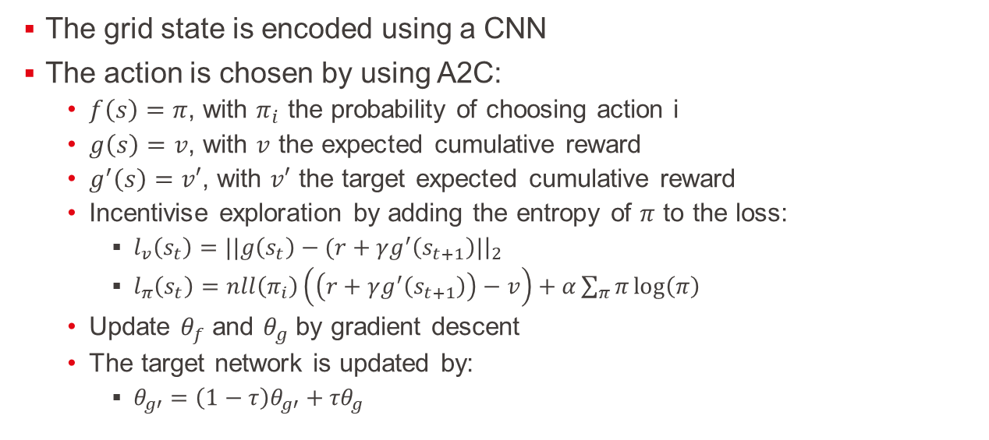
Model
The grid state is encoded using a CNN
The action is chosen by using A2C:
$f\left(s\right)=π$, with $π_{i}$ the probability of choosing action i
$g\left(s\right)=v$, with $v$ the expected cumulative reward
$g^{′}\left(s\right)=v′$, with $v′$ the target expected cumulative reward
Incentivise exploration by adding the entropy of $π$ to the loss:
$l_{v}\left(s_{t}\right)=||g\left(s_{t}\right)−(r+γg^{′}\left(s_{t+1}\right)|{\left.​\right|}_{2}$
$l_{π}\left(s_{t}\right)=nll\left(π_{i}\right)\left(\left(r+γg^{′}\left(s_{t+1}\right)\right)−v\right)+α\sum_{π}{π}\log\left(π\right)$
Update $θ_{f}$ and $θ_{g}$ by gradient descent
The target network is updated by:
$θ_{g′}=\left(1−τ\right)θ_{g′}^{ }+{τθ}_{g}^{ }$

Slide 18
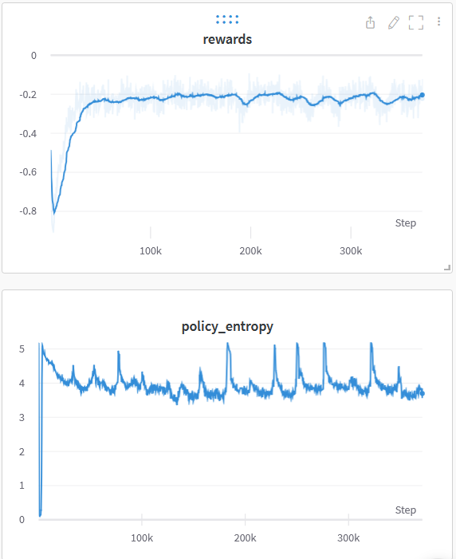
Results
Not a good convergence at the moment
Trainings takes ~4h
For ~350k steps

Slide 19
Next steps
Tuning the hyperparameters of A2C
Change the architecture of the encoder to instead use a graph-based approach
Try to model the construction task as a non-sequential Markov game
Leverage concept from game theory to improve the results

Slide 20
Extra material

Slide 21
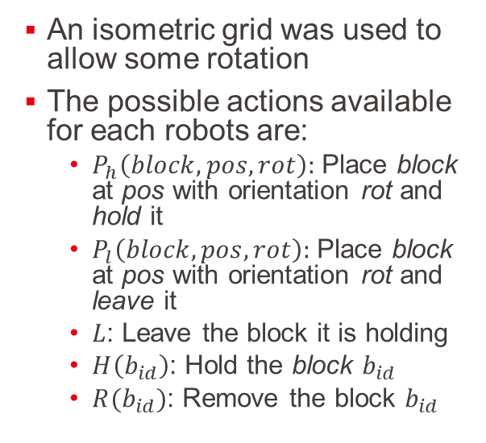
Discrete simulator
An isometric grid was used to allow some rotation
The possible actions available for each robots are:
$P_{h}\left(block,pos,rot\right):$ Place block at pos with orientation rot and hold it
$P_{l}\left(block,pos,rot\right):$ Place block at pos with orientation rot and leave it
$L$: Leave the block it is holding
$H\left(b_{id}\right)$: Hold the block $b_{id}$
$R(b_{id})$: Remove the block $b_{id}$

Slide 22
Discrete simulator
Different feasible action set:
All the actions are feasible
An action is feasible only if the new block touches an existent side
An action is feasible only if the new block touches a side from the last block

Slide 23
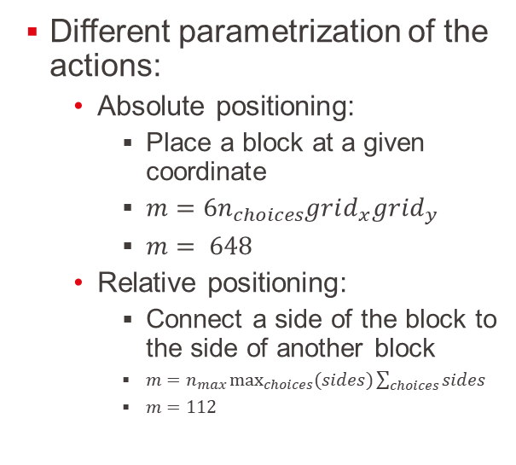
Discrete simulator
Different parametrization of the actions:
Absolute positioning:
Place a block at a given coordinate
$m=6n_{choices}grid_{x}grid_{y}$
$m= 648$
Relative positioning:
Connect a side of the block to the side of another block
$m=n_{max}\max_{choices}{(sides})\sum_{choices}{sides}$
$m=112$

Slide 24
Animations
All possible actions on a hexagon
Physics model
Log from the training

